Slide 1
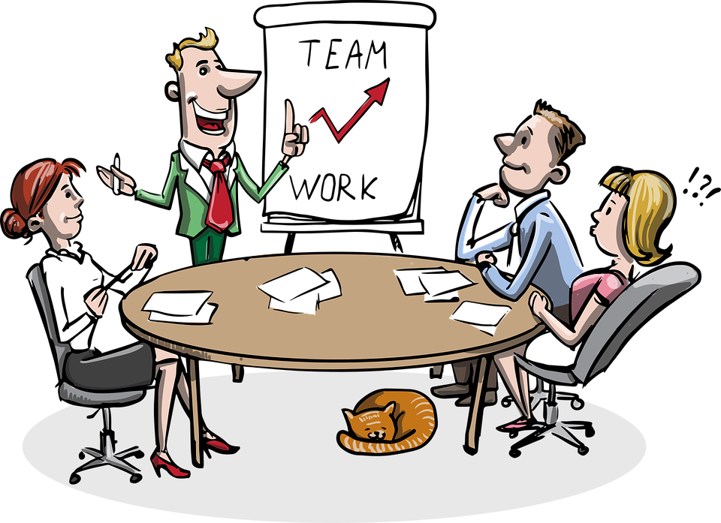
Foundations of Entrepreneurship
Founding Team and Early Recruits

Slide 2
Importance of the founding members.
Issues to be considered for selecting co-founders.
Founders’ mentality
The considerations for recruiting employees at early stage.

Slide 3
“There is one thing stronger than all the armies in the world, and that is an idea whose time has come.” Victor Hugo
That tries to show that an idea at an appropriate time is the most powerful in entrepreneurship
But if you do not have the PEOPLE to smartly execute the idea, someone else will do.
Team is the greatest differentiator

Slide 4
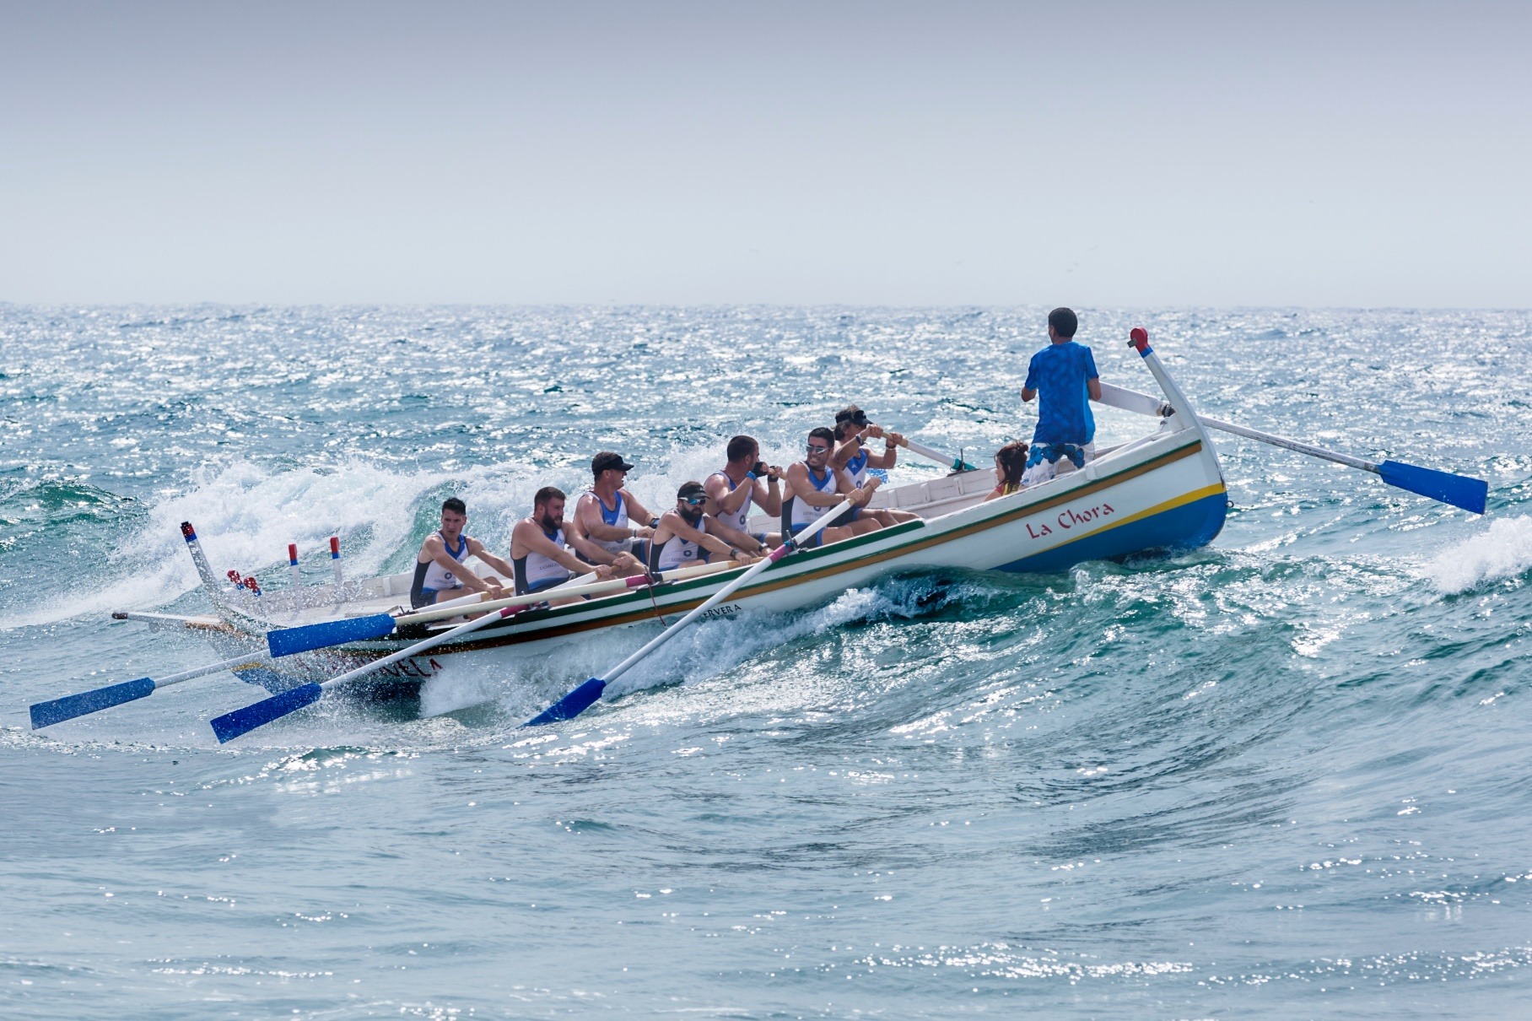

A Perfect Team Can Circumvent Any Odd
Photo by Quino Al on Unsplash

Slide 5

Even the Most Adventurous one
Photo by Rune Haugseng on Unsplash

Slide 6
The Team
The team: individuals with complementary skills.
A great team has all critical competencies for efficient execution.
A high level of collaboration among the team members.
Committed to a common goal.
Share the same vision.
Initial employees are as good as cofounders and hiring decision should be based on missing skills.

Slide 7



The Entrepreneurial Journey Shared Commitment at its best:
The story courtesy the book: Creating Teams With an Edge: The Complete Skill Set to Build Powerful and Influential Team by Harvard Business Publishing
Photo by Luis Villasmil on Unsplash

Slide 8




Importance of Balanced Team
Some experts relate selecting co-founders with finding prospective match for marriage.
But co-founders have greater challenges to resolve together and need full commitment.
Many startups fail very early due to founder disputes.
About 70% of the weight on investment decisions by VCs is on the team elements or the human capital and their commitments.
A balanced team is very critical to success of any venture

Slide 9
Building a Balanced Team
New ventures are replete with enormous uncertainties and risks. Co-founders, early employees, advisors, and mentors can break barriers, overcome problems and can translate a losing proposition into a winning one.
In today’s world, startups, in general, have access to need-based capital and technologies. Team of co-founders, early employees, and mentors are the real differentiators for a start-up 👆.
On the flip side, you end up spending all your time and energy resolving conflict with the cofounders and the progress will take a back seat 💺.

Slide 10



Life as a CEO Can Be Very Lonely
Your journey as a founder is likely to be harder than you envision as the worst-case-scenario.
Your hard skills, resilience, vision, passion, and courage can take you so far.
While these are prerequisite to create new venture, complementary skills of co-founders are real ammunitions for success.
Steve Jobs, Larry Page and Elon Musk — have achieved greatness by investing in building well balanced teams early on and sustained all the way.
Thomas Alva Edison had attributed his 2332 granted patents and commercialization to different teams spearheading different innovation initiatives.

Slide 11
A Great Team is Key to Success of a New Venture
“You may have a great business idea, solid financial backing, and optimistic market research, but if your founding team doesn’t have the right balance of personalities and skills, you could soon be closing up shop”
"Having the right team determines the path and outcome of a new venture more than any decision in the lifecycle of a company," Bernd Schoner, the author of The Tech Entrepreneur’s Survival Guide (McGraw-Hill, May 2014).
"The founding team cannot be changed, and no one can speak to investors or customers with authority like a founder," he says. "It’s a great asset to have at the beginning and hard to add later.“
"Adding a cofounder with whom you do not have a long history is almost always fatal” - Sam Altman.

Slide 12

As per Sam Altman (Y-Combinator President) https://www.ycombinator.com
https://startupclass.samaltman.com
Twenty most valuable companies have at least two co-founders.
Startups with 2 – 3 co-founders work best.
Five and more co-founders should be avoidable.
Never choose co-founders without long-term acquaintance.
Lone founder is absolutely avoidable.
However, it is better to have no co-founder than bad co-founder. So continue to look for suitable co-founders.

Slide 13
Know What You Need
Clearly define your vision and values.
Make clear assessment of the skills you need.
Assess your own strengths and weaknesses.
Identify suitable persons with the critical missing skills and who would share the same vision.

Slide 14
Know What you Need
Check the level of drive and motivation in individuals.
Humility, openness to new ideas, and readiness to collaborate on decisions are very important.
Emotional buoyancy – keeping cool at times of despondency.
Personal honesty.

Slide 15
A Team Member may Bring the Following Values
Drive
Entrepreneurial instincts
Domain knowledge
Business process management skill
Intelligence / Creativity
Track record / Credentials
Past collaboration
Shared vision and values

Slide 16
The Google Team
1995
1996
1997
1998
Larry Page and Sergey Brin meet at Stanford. Larry, 22, a University of Michigan graduate, is considering the school; Sergey, 21, is assigned to show Larry around.
Larry and Sergey begin collaborating on a search engine called BackRub. BackRub operates on Stanford servers for more than a year—eventually taking up too much bandwidth.
Google.com is registered as a domain on September 15. The name—a play on the word "googol," a mathematical term for the number represented by the numeral 1 followed by 100 zeros—reflects Larry and Sergey's mission to organize a seemingly infinite amount of information on the web.
Sun co-founder Andy Bechtolsheim writes a check for $100,000 to an entity that did not exist yet—a company that was later called Google Inc.

Slide 17
Issues to Consider for Building a Team
1. Team Size: A team of two to three founders seems ideal.
2. A leader to break deadlock among parties
3. History of founder working in stressful situation:
4. Founders Goals: All founders need to be on the same page as regards future goals – financially, career wise, socially and geographically – with timeframes? (e.g. “exit” scenarios)
Notes:
Do you have a diverse set of skills on your team ideally including product/technology, customer/sales skills, people management skills, entrepreneurial spirit (i.e., fearless & able to operate in ambiguity), general problem solver, business skills (especially from an entrepreneurial environment)?

Slide 18
Issues to Consider for Building a Team
5. CEO role.
6. Equity Philosophy: Initial allocation and future accretion.
7. Shared Vision: Is there a core vision drawing the team together?
8. Shared Values: Common core values make the team a strong unit?

Slide 19
Issues to Consider for Building a Team
9. Commitment: Commitment levels of each founder should be very clear?
10. Mix of Skills: Your business needs many skills. Find people with multiple skills and try to fill any gap.
11. Trust and Confidence: Do you have trust and confidence in your co-founders?
12. Likability: Can you see working with your co-founders for the next five years? Do they give you energy or not?

Slide 20
More about Balanced Team
Founders need to be unflappable, tough, they know what to do in every situation. They act quickly, they're decisive, they're creative, and they're ready for anything (Sam Altman).
Communication – founders should be able to communicate effectively with the entire team to give a sense of belonging, common goal and for a shared vision.
Team benefits from having an analytical thinker who is detail-oriented, process focused, identifies and focuses on the sub-tasks needed to achieve the goal.
Notes:
An effective team is composed of people who collectively bring all such critical competencies to the effort. Any weak or missing competencies jeopardize the team goal. The key action is to understand the missing competency and identify talent and induct in the team so as to fill that gap. Unflapple – calm under crisis

Slide 21
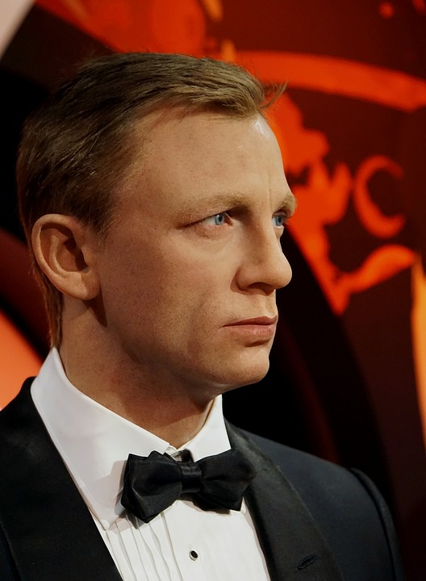
A Balanced Team to Have the Following Experts
A product expert (Prima Donna and Superstar). That person would turns the problem and customer knowledge into a workable prototype and do things that scale.
A Leader – who has sway on everybody and mitigates interpersonal crisis.
An industry expert – with deep experience
A marketing expert – who knows the mantra to sell whatever you make
A financial expert – ensures need and source of money in time proactively.
A person with a fat purse – who is ready with fund as and when necessary.

Slide 22
More about Balanced Team
Sharing knowledge and skills - proactively sharing knowledge and skills with others in the team greatly benefits the team and the venture.
A good test of goal alignment is to let each team member pitch before an independent person. If all the members articulate the same business model the team is synchronized to a common goal.
The goal is not mere vision oriented; but requires strict adherence to performance metrics.
A shared understanding of the goal is extremely important, but commitment to the goal is even more important.
Every member contributes - every member benefits: Members showing up to attend meetings and rendering opinions but not doing work as expected, impair performance and demoralize the active teammates.

Slide 23
Experience of Bad Team Member
Schoner cofounded the radio frequency identification technology company ThingMagic with four fellow Media Lab graduates at the MIT, and experienced a year of "extreme turmoil."
"We had worked together before and were convinced we knew each other well," he says. "But once you start a company, outside pressure causes people to act differently. That was, for me, one of the most traumatic experiences in my early years. A fundamentally different environment changes people, and how they react."
"The founding team cannot be changed, and no one can speak to investors or customers with authority like a founder," he says. "It’s a great asset to have at the beginning and hard to add later.” Schoner

Slide 24
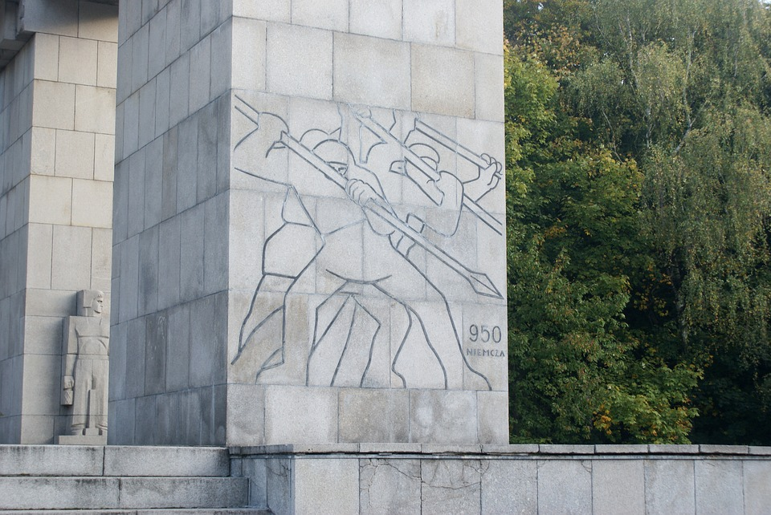

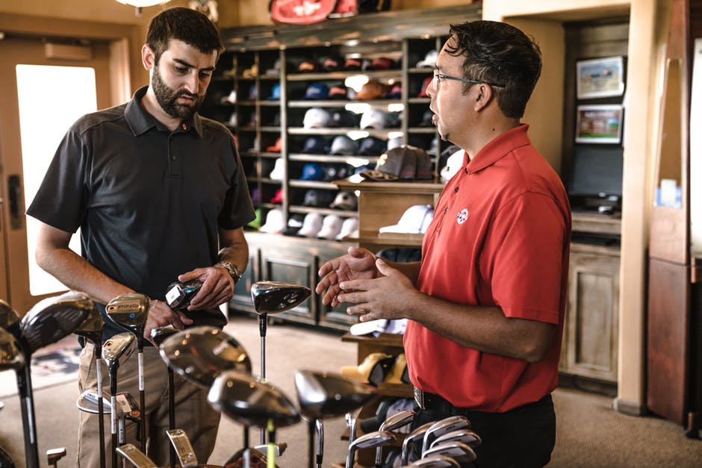
Know the Founder’s Mentality
New ventures should begin with insurgents mission—fast, customer-focused, agile and adaptable.
Research shows that causes of failure of 90% of the companies are internal – particularly as companies scales, their founder’s mentality is lost, though there is always an external narrative.
Founder’s mentality consists of three traits: an insurgent’s mission, an owner’s mindset, an obsession with the front line.
Notes:
Give a sense that everyone’s opinion matters. Delegate, empower, and have clear goal, mission, vision.

Slide 25
Know the Founder’s Mentality
A strong insurgent mission keeps you externally focused on the problem you want to solve. You never lose focus and work relentlessly to keep the promises to customers, by continuing to innovate on their behalf. Almost radically passionate.
The speed of execution, focus to value proposition, and connection to customers are part of insurgent mentality.
Owner’s mentality: Accountability, actions that are for the best interest of the company and voicing anything that goes against. In short, it is the growing sense that success of the company is their personal success.
Front line obsession: Do everything to satisfy existing customers, acquire and retain new customers. Innovate continuously.
Notes:
Give a sense that everyone’s opinion matters. Delegate, empower, and have clear goal, mission, vision.

Slide 26
The companies that have grown profitably to scale often consider themselves insurgents, as if they are waging war on their industry and its standards on behalf of an underserved customer, or creating an entirely new industry altogether.
Such companies possess a clear sense of mission and focus that everyone in the company can understand and relate to.

Slide 27
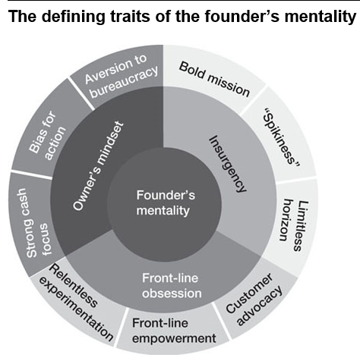
Zook, C., & Allen, J. (2016). The Founder's Mentality: How to Overcome the Predictable Crises of Growth.

Slide 28
Front-Line Obsession
Most founders are the first salesperson, its first product developer, or both.
They live and breathe the front line, driven by an intellectual curiosity about every detail of the customer experience.
They use instincts formed at the ground level to make every decision.

Slide 29
Owner’s Mindset
“The difference between employees who operate with the owner’s mindset and those who don’t, can be as great as the difference between devoted parents and restless babysitters.”
Zook, C., & Allen, J. (2016). The Founder's Mentality: How to Overcome the Predictable Crises of Growth.

Slide 30
Hiring Early Employees
You may ignore the remainder of the slide deck. I am keeping them for those who may be interested. For examination purpose, you may ignore.

Slide 31
Early Hire: Hire only the best talent
You get to know them if you have worked with them for some time. So try to work in a project to know them. Are they among the top 5% of the people?
Good communication skill is great asset.
Risk taking attitude is essential.
Work with people and check if you genuinely like and respect and you have known long enough to be sure.

Slide 32
Mark Zuckerberg Would Hire Those Who
Are Smart
Get things done.
He would like to understand: “Do I want to spend a lot of time around them?”
“I would like those whom I shall feel comfortable reporting to”
Those who are manically (obsessively) determined.
People with good communication skill.

Slide 33
Early Recruits
Talented early employees can fill some of the skill gaps.
They have the founder’s mentality and drive company’s sustainable growth.
Top talents are in limited supply. Being at early stage, startups are at a disadvantage to attract and screen the best talents.
Thankfully, highly creative talents like to experiment in early-stage startups. You have to find them.
You have to seek them out instead of expecting them to seek you out.
Batch mates, co-workers, and friends with long association are natural choices.

Slide 34
Early Recruit
Many of them like to feel the excitement of the startup without having too much stake.
They are motivated by the opportunity to work on a problem that is core to a company’s main business.
They look forward to an open environment where their activities are not bounded by rules.
They get a chance to build brand, develop product from the ground up.
Early-stage employees may also aspire to opportunity to create personal wealth through equity.

Slide 35
Early Recruit
One key issue to remember is that firing a person for non-performance is more difficult than hiring.
You have to be sure about the right person.
Hire only when scaling, balancing key skill deficit, diversifying, particularly when you are bursting at the seams.
Number of employee is a vanity metric that must not be chased.
More employees than what are necessary create huge problems such as high burn rate, slow decision process, complexities, lower efficiency and the list goes on.
Hiring requires time; so plan in advance.

Slide 36
Prepare yourselves
Create a clear profile of the potential talent. Usually, people use the acronym CAPS, which stands for capacity (capability), attitude (self-motivated, adaptability to change, ethics, team player, hardworking, knowledge seeking, self-assured, passionate), personality, and skills.
Take a marketing approach to recruiting. Create a compelling story about your company vision and see how it can align with objectives of individuals.

Slide 37
Who Are the Right Persons
Failed or successful startup cofounder
Working experience in startups
Person with demonstrable creative talent
Founder aspiration
Persons with international experience
Person initiated personal projects
Small business owner
Openness to learn new techniques
Action oriented, self motivated, result oriented,
Treat customers as individuals rather than (great employees are focused on solving problems of customers)
They are aware of the company mission and passionate to remain focused to achieve it.

Slide 38
Undesirable Traits
People with long experience in established companies
Job hoppers
Interested in high designation
Think money as main ingredients in everything

Slide 39
How to Identify Talent?
Participate in hackathons, conferences, and competitions and make connections.
Use your peer network.
Use social media.
Must not be done in a hurry.
Do reference check for antecedents.

Slide 40
Some Dos and Don’ts
Do reference check for antecedents. Check if the person is a super performer. Even a fresher may have demonstrable capability in some of their projects.
Try hiring and retaining the best talent even at a high salary (both cash and equity). One great employee can take the company to places.
Check if the company mission is aligned with the personal mission.
If in doubt, do not make a decision to hire. Investigate till you are absolutely sure.
Test skill on actual environment such as pair-programming.

Slide 41
Some Dos and Don’ts
If an employee is not effective or a trouble maker, fire early. The best time is now. Good for the company and for the employee.
Train them in respective fields.
One may not be a natural manager. You have to teach them.
Every new employee redefines the cultural mix of the company at early stage. Keep that issue in mind.
Notes:
Pair programming is an agile software development technique in which two programmers work together at one workstation. One, the driver, writes code while the other, the observer or navigator, reviews each line of code as it is typed in. The two programmers switch roles frequently.

Slide 42
Zook, C., & Allen, J. (2016). The Founder's Mentality: How to Overcome the Predictable Crises of Growth. Harvard Business Review Press.
Creating Teams With an Edge: The Complete Skill Set to Build Powerful and Influential Teams by Harvard Business Publishing, 2004
https://medium.com/f2-capital/how-vc-investors-examine-startup-teams-fb7a436218c2
Harvard Business Review Entrepreneur's Handbook (HBR Handbooks) by Harvard Business Review
https://startupclass.samaltman.com/
The Tech Entrepreneur's Survival Guide: How to Bootstrap Your Startup, Lead Through Tough Times, and Cash In for Success–by Bernd Schoner, McGraw-Hill, 2014
Images are from (i) https://pixabay.com and (ii) https://pexels.com
https://www.entrepreneur.com/article/240883 - article by Dharmesh Shah - Co-Founder and Chief Technology Officer, HubSpot

Slide 43
Complementary skills and professional abilities, mutual respect, strong leadership, synchronization, and communication of team members with one another, both on the professional and the interpersonal levels are key to decide on team members.
Recruit only to fill critical skill deficiencies.
Check that the potential talent gels well with rest of the team and is aligned with the company vision.

Slide 44
Thank you

